Slide 1





AwareAI
Mission Statement:
To provide and enable strategic threat context and response in the wake of sophisticated security needs
Year of Establishment | 2025
Headquarter | Santa Clara, CA
Company Domain | Cybersecurity
Target Market | Security Information and Event Management
Aishwarya Lakshmi Keshava
Neha Kumari
Khushali Rathod
Sangita Poudel

Slide 2
Business Objectives
Challenges
✅ Improve SOC Efficiency – Automate alert triage & reduce manual investigations by 50%.
✅ Accelerate Incident Resolution – AI-driven contextual insights reduce response time by 60%
✅ Optimize Analyst Productivity – Automate repetitive tasks, saving 700+ hours per year.
✅ Enable Intelligent Decision-Making – Provide real-time, context-aware intelligence and recommendation
🔴 Alert Fatigue & Overload
🔴 Slow Investigation & Response Times
🔴 SOC Burnout & Talent Shortage
🔴 Lack of Contextual Intelligence
Notes:
🔴 Alert Fatigue & Overload – SOC teams receive thousands of alerts daily, with 45% going uninvestigated due to lack of resources.
🔴 Slow Investigation & Response Times – Manual correlation of logs, policies, and user behavior delays threat response.
🔴 High False Positives – Traditional SIEM/XDR solutions rely on static rules, leading to wasted analyst time.
🔴 SOC Burnout & Talent Shortage – 70% of SOC analysts experience burnout, leading to high turnover rates and operational inefficiencies.
🔴 Lack of Contextual Intelligence – Existing tools detect threats but fail to provide actionable insights or recommend next steps.
✅ Enhance SOC Efficiency – Reduce alert investigation time by 50%, freeing analysts for high-priority tasks.
✅ Increase Threat Detection Accuracy – Reduce false positives by 40% through AI-driven contextual correlation.
✅ Automate Incident Response – Provide real-time recommendations for blocking, escalating, or investigating threats.
✅ Improve Security ROI – Reduce breach-related costs by $1M+ annually, saving 1000+ analyst hours per year.
✅ Future-Proof Cybersecurity Operations – Leverage AI-driven continuous learning to improve response over time.

Slide 3
Problem Statement
“To develop an AI-driven RAG Security Analyst Assistant to help analysts investigate security incidents with context, and gain insights on how to respond to them effectively”

Slide 4

‘Magic Quadrant’ Analysis
Gen AI Capabilities
Context-aware AI (Policy, User Behavior) - Automated Recommendations,Reduced MTTR & Alert Fatigue
AwareAI
Real-time threat detection and investigation capabilities,Lacks comprehensive AI-driven automation for response actions
Netwitness
Innovation
Market Readiness
Lacks native AI-driven alert correlation.
Splunk
Vision

Slide 5
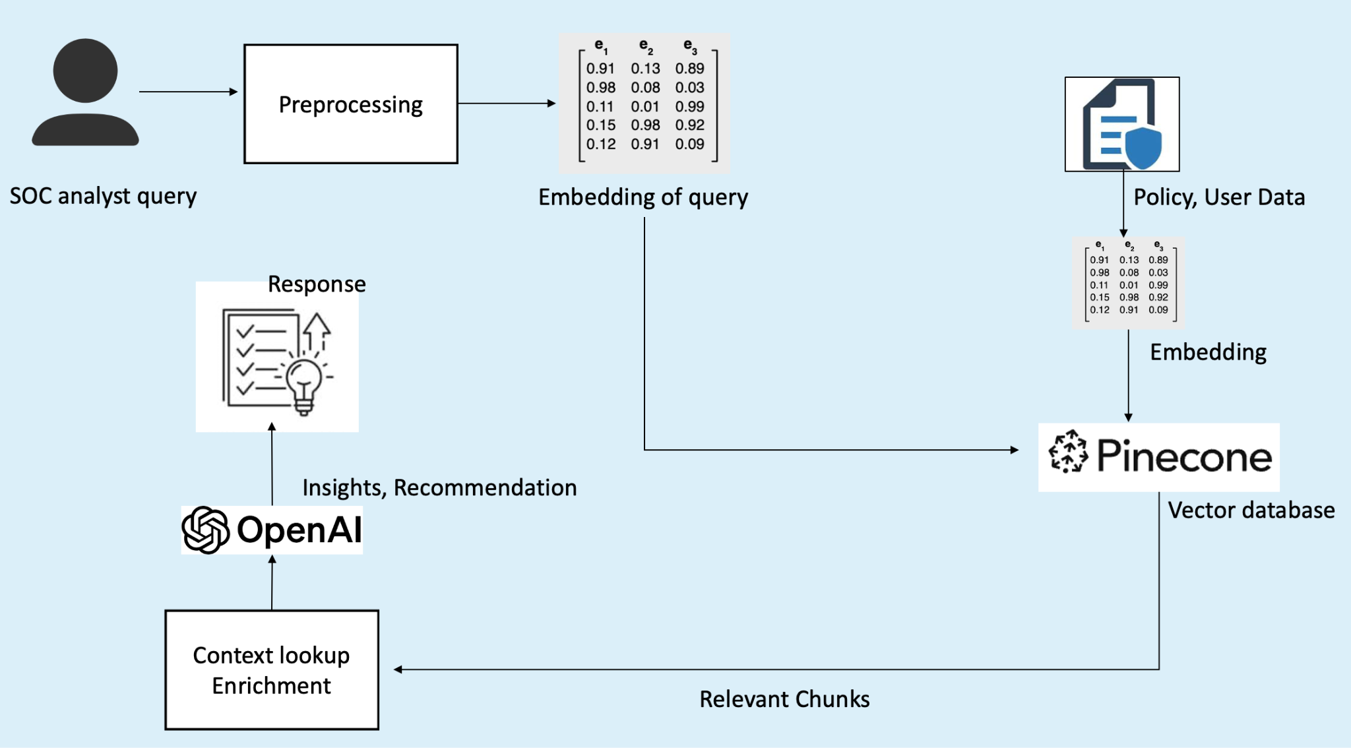
High Level Design (RAG Model)
G
A
R

Slide 6
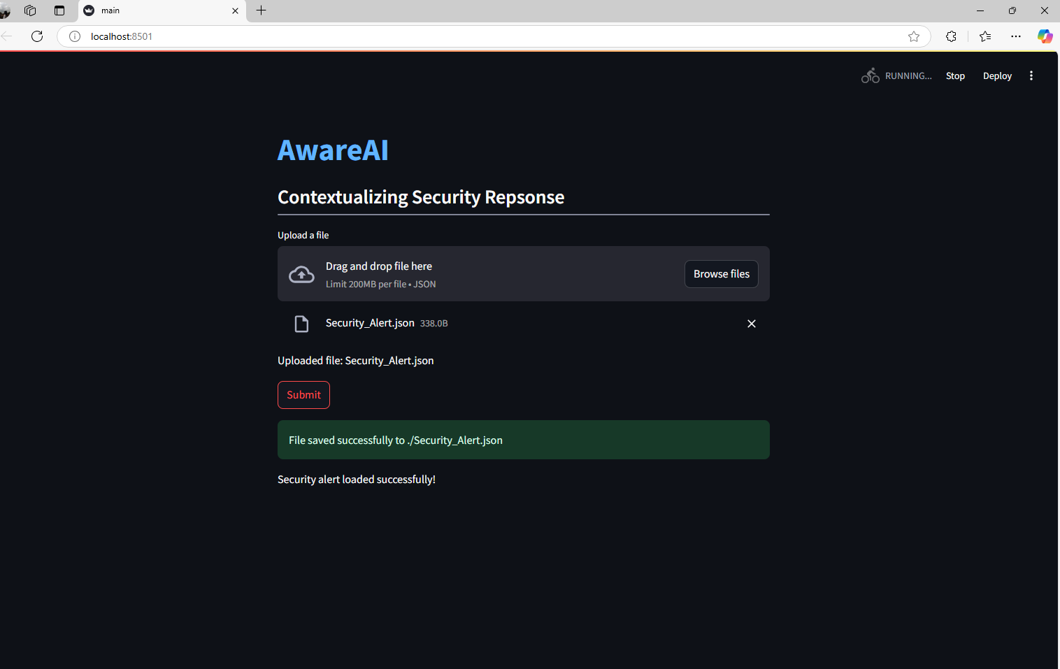
UI

Slide 7
ROI
Category | Before Aware AI Implementation | After Aware AI Implementation
Annual Cost of Analyst Time | $1.25M | $685K
Time Spent on Alerts | 80.4 hours | 44.2 hours
AI Implementation Cost | - | $250K
Annual AI maintenance cost | - | $50K
SOC Team Size: 10 Analysts
Average Analyst Salary: $130,000 per year
Time spent per alert (manual investigation): 40 minutes
Average alerts per day: 120
Reduction in investigation time with AI: 45%
Current Security Operations Cost: $450,000 per year
AI Assistant Implementation Cost: $250,000 (one-time setup)
Annual AI Maintenance Cost: $50,000
Total Annual savings= $565K
ROI= 88.33%

Slide 8
ROV
Time Efficiency | Reduces investigation time by 45%, enabling faster threat resolution. AI-driven automation significantly improves response time, reducing the Mean Time to Respond.
Resource Optimization and Cost Efficiency | Given the average cost of a data breach at $4.2M, even an 8% reduction in breach risk translates into estimated savings of $336K- per year.
Consistency and Reproducibility | Ensures standardized threat response and minimizes human error in security operations.
Rapid Feedback and Continuous Improvement | Leverages AI-driven insights for proactive security enhancements and evolving threat landscapes.
Backup

Slide 9

Demo
Notes:
https://drive.google.com/file/d/1BncbD_kybQdG0pHfY_g5ATadmdUi5PfK/view?usp=drive_link

Slide 10
Thank You

Slide 11
Q&A

Slide 12
Appendix

Slide 13
Future Scope and Implementation of AwareAI
Cloud and On-Premise Deployments – Enhancing deployment flexibility to support both cloud-native and on-premises security environments.
Enhanced AI Capabilities – Future iterations can integrate more advanced LLMs and deep learning models, AI predictive analytics to improve threat detection, automate response actions, and enhance contextual intelligence.
Real-time Threat Intelligence – Implementing live data feeds from global threat intelligence sources to proactively defend against emerging cyber threats.
Integration with Additional Security Platforms – AwareAI can expand its compatibility with more SIEM and SOAR platforms
Scalability for Enterprises – Expanding AwareAI’s architecture to support large-scale enterprises with multi-layered security needs.

Slide 14
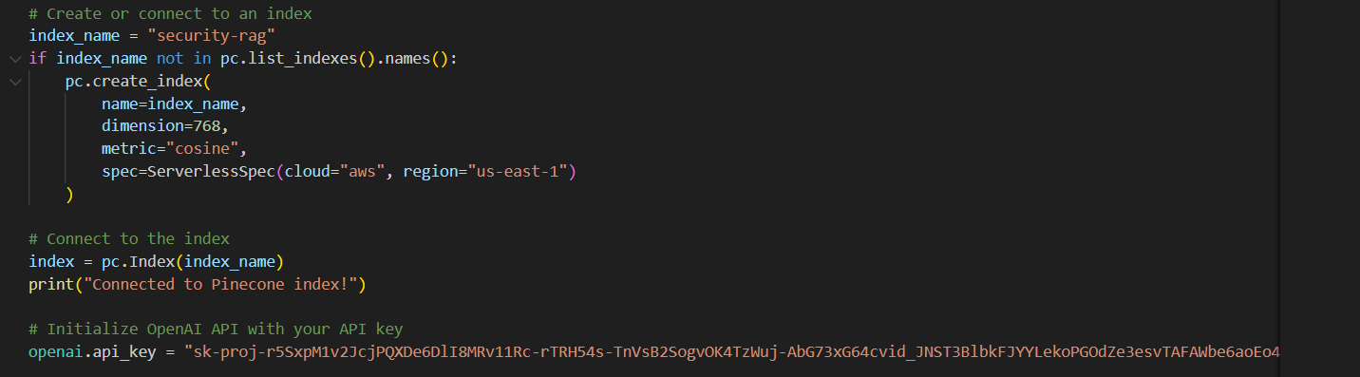
Backend

Slide 15
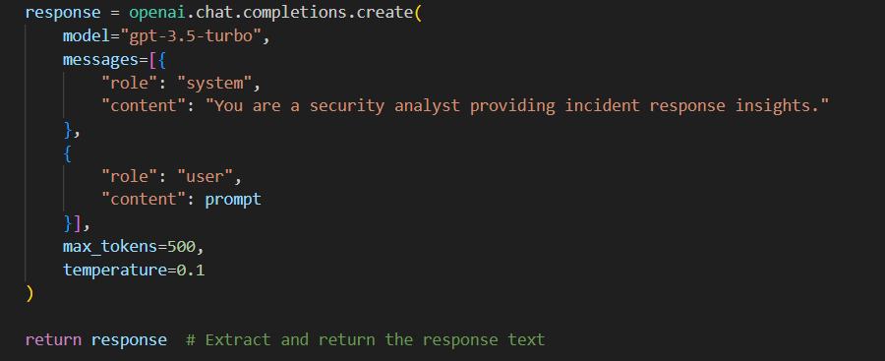

Slide 16
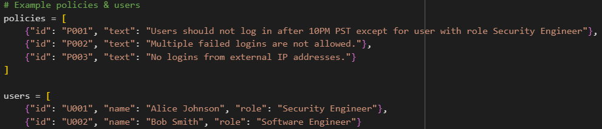

Slide 17
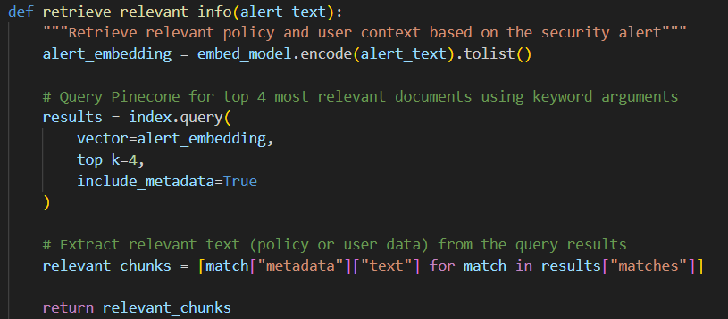

Slide 18
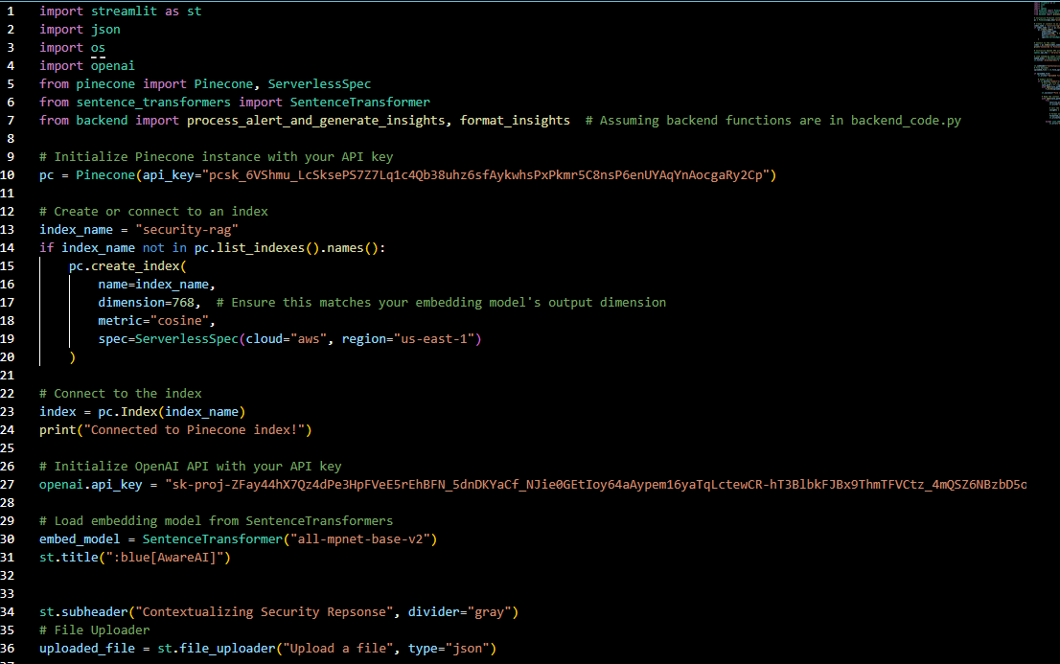
Frontend

Slide 19
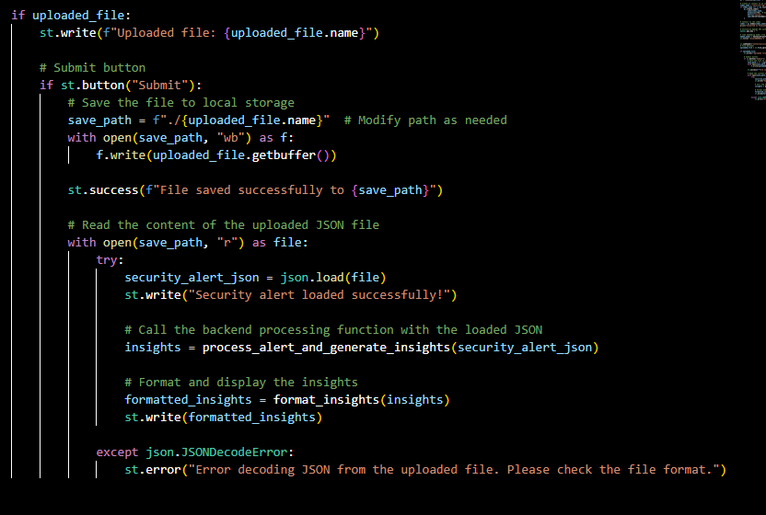

Slide 20
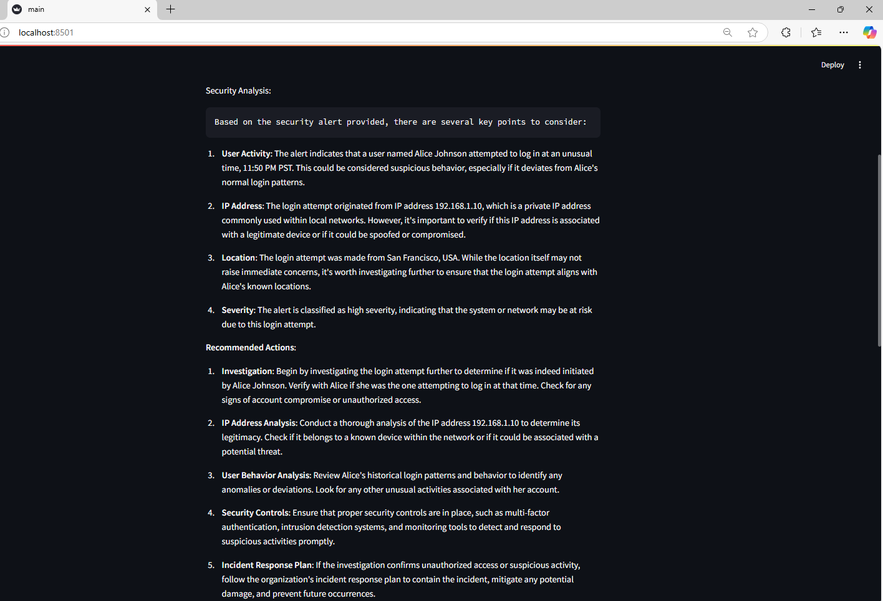

Slide 21
Tech Stack
LLM : GPT 4
Vector database : Pinecone
Front end : Streamlit
Embedding : Hugging Face Sentence Transformers

Slide 22
ROI Calculation for Year 1
Total Investment in Year 1 One-time AI Implementation Cost+Annual AI Maintenance Cost = 250K+50K=300K
Total Savings (Gains) in Year 1=565K
ROI Calculation: ROI=[(565K−300K)/300K]100 =88.3%

